Slide 1
A study of synchronization and concurrency issue in the dining philosophers problem
Submitted by: Rochelle Mullen B00156311
Steven Kelly B00150588
Habiba Nour B00151078
Piotr Momat B00156112

Slide 2


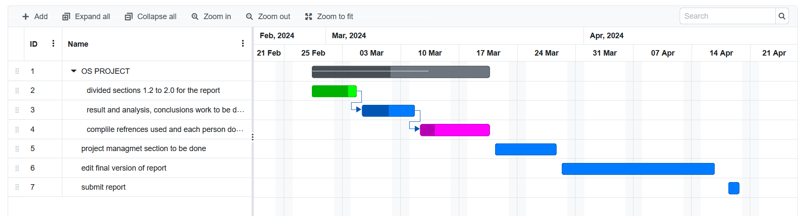
Introduction
Concurrency and Synchronisation Issues in OSes
Mutex Locks
Semaphores
The Dining Philosophers Problem with Four Chairs
Makefile
Analysis
Conclusion

Slide 3
Concurrency Issues in oses
Concurrency: OS ability to execute simultaneous tasks
Independent processes and Cooperating processes
Deadlock: Processes/ threads are waiting for release
Starvation: Thread can’t gain access to shared resources, cannot progress
Blocking: System call where process execution is blocked until requested operation is complete

Slide 4
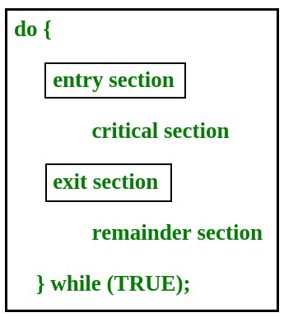
Synchronisation issues in oses
Synchronisation: Control of multiple processes with shared resources and data in an operation system
Entry section, critical section, exit section, remainder section
Race condition: Multiple processes racing when modifying a shared resource
Critical section problem
(Image sourced from: https://media.geeksforgeeks.org/wp-content/cdn-uploads/gq/2015/06/critical-section-problem.png)

Slide 5
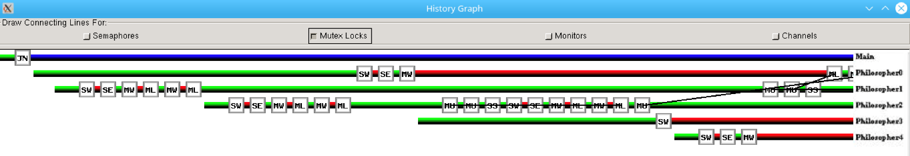
Mutex Locks
Locks work In pairs
Philosophers pick up on chopstick and lock then pick up other if free
Can lead to starvation if all pick up right chopstick at one time
Has lock method and unlock method
Source: ThreadMentor: Visualising Dining Philosophers: with Four Chairs

Slide 6
Semaphores
Semaphore is an extension to mutex locks
It has 2 methods (Wait and Signal). Each method has two possibilities
2 possibilities for Wait when it is executed by a thread: the counter of semaphore is either positive or zero
2 possibilities for Signal when it is executed by thread: the queue of semaphore has no waiting thread or has a waiting thread
Binary semaphores i.e if the element is 0 that means that element need to wait. All elements that need to be executed need to initialized to 1
Wait and Signal are atomic which means once Wait is released, elements will continue with no interruption.

Slide 7
The Dining Philosophers Problem with Four Chairs
Only allows 4 philosophers to sit at the table
Has a private queue and counter
Each chopstick is declare individually
When philosopher sits down to eat they must wait on semaphore before picking up chopsticks
Must signal when finished eating to release chair so another can sit in it
Deadlock free solution

Slide 8
MAKEFILE
This Makefile is designed for compiling C++ programs. It specifies the compiler command(CMD), allows for passing a CMD value, and defines the paths to the source files and libraries used in the compilation process.
For our case we need only three files to compile:
First: Philosopher-4chairs.h: Foundation and takes two arguments: NUMBER(philosophers), and ITER(eating cycles).
SECOND: Philosopher-4chairs.cpp: Establishes rules(Semaphors, Mutex Locks), acts like a bouncer with help of semaphores and Mutexes locks, to make sure everyone picks up and puts down their chopsticks and seats
THIRD: main.cpp: Depends on eating cycles, generates threads for each philosopher, waits for everyone to complete, and exiting(ends the program).
Code snippets were taken from: https://pages.mtu.edu/~shene/NSF-3/e-Book/SEMA/TM-example-philos-4chairs.html

Slide 9

FILEs after compilation
We can remove Makefile after we compile the program.
Compilation also generates three classes.
Screenshot was taken in Mageia8 (22/04/2024)

Slide 10
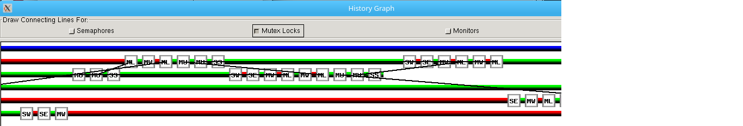
Tags used in our solution int threadmentor
Screenshot is from ThreadMentor four chair solution was taken on 20/04/2024
.SW: Semaphore Wait: A Philosopher attempts to sit down, but all chairs are occupied(decrements the semaphore).
.SE: Semaphore Enter: The Philosopher sits down which decrements semaphore.
.SS: Semaphore Signal: The Philosopher gets up, which increments semaphores and allows others to sit down.
.MW: Mutex Wait: One of the Philosophers trying to pick up a fork(mutex), but fork is already in use.
.ML: Mutex Lock: One of the Philosophers picks up a fork(mutex) and locks the mutex lock.
.MU: Mutex Unlock: Philosopher puts down a fork and unlocks the mutex lock.

Slide 11
Analysis and Results:
1. Starvation example
Catching a starvation was unsuccessful due to a very less chance of occurrence, but:
.Starvation is a problem that occurs when high priority processes keep executing and low priority processes get blocked for indefinite time. In heavily loaded computer system, a steady stream of higher-priority processes can prevent a low-priority process from ever getting the CPU. In starvation resources are continuously utilised by high priority processes. (GeeksforGeeks, 2024).
.Problem of starvation can be resolved using Aging. In Aging priority of long waiting processes is gradually increased. (GeeksforGeeks, 2024).

Slide 12

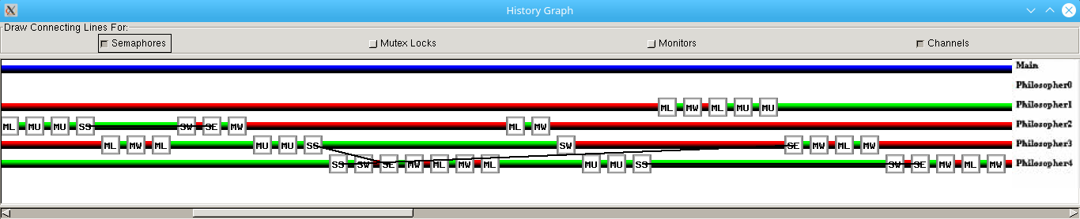
Analysis and Results:
2. SEMAPHOREs example
Screenshots are from ThreadMentor four chair solution was taken on 20/04/2024
Philosopher0 finished eating, because thread is finished. Philospoher1 was locked from eating(red line) and MU means chopsticks are unlocked and he is eating. Philosopher2 is in wait phase(MLW). Philosopher3 was eating, after semaphore signal, the Philosopehr3 had to give up the chair, and once he took his seat back(SE) he waited for the chopstick(MW). Philosopher4 was eating, after he gave a signal(SS) so bouncer asked him to wait, and after some time he entered eating again(SE) and MW means he waited for chopsticks.

Slide 13

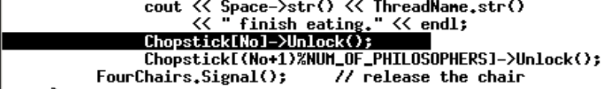
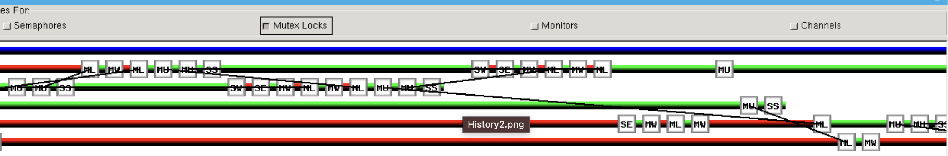
Analysis and Results:
3. MUTEX lock example
Screenshots are from ThreadMentor four chair solution was taken on 20/04/2024
Philosopher0 was waiting for a chopstick(MW), Philosopher1, released when finished eating and Philospehr0 started eating. Philosopher2 was eating (green line) than unlocks (MU and gives up the seat(SS). Philosopher3 was standing and enters(SE) and waits for a chopstick. Philosopher4 was waiting for a chopstick and once Philosopher2 finished eating, Philosopher4 clicked it up and locked.

Slide 14
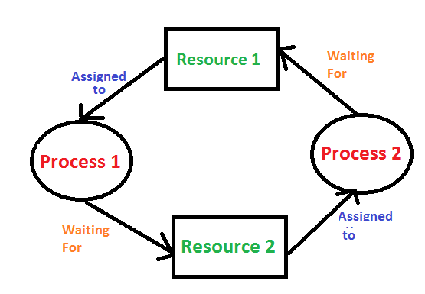
Analysis and Results:
4. DEADLOCK example
/Our case excludes a deadlock.
.A Deadlock is a situation where each of the processes waits for a resource which is being taken by some another process. (Javatpoint, 2024)
.In this situation, none of the process gets executed since the resource it needs, is held by some other process which is also waiting for some other resource to be released. (Javatpoint, 2024)
Source: https://media.geeksforgeeks.org/wp-content/cdn-uploads/gq/2015/06/deadlock.png

Slide 15
CONCLUSION
Our solution prevents deadlock
May have issue with long wait times as one philosopher can eat and think quicker
Advantages of semaphore: Synchronization, flexibility and efficiency
Disadvantages of semaphore: complexity, overhead, race condition, starvation

Slide 16
References
Dining Philosophers Problem. 2020, miro.medium.com/max/662/1*bBGR80ixw0l6ZELyNh7fxw.png. Accessed 13 Feb. 2024.
GeeksforGeeks. (2024), Difference between Deadlock and Starvation in OS. Retrieved April 24, 2024, from https://www.geeksforgeeks.org/difference-between-deadlock-and-starvation-in-os/
Javatpoint, (2024). OS Deadlocks Introduction. Accessed April 24, 2024, from https://www.javatpoint.com/os-deadlocks-introduction
Dr. C.-K. Shene. Multithreaded Programming with ThreadMentor. Aug. 2001, COMP H2014 KF: ThreadMentor E-Book (tudublin.ie). Accessed 31 Jan. 2024.
Neso Academy. “The Dining Philosophers Problem.” https://www.youtube.com/watch?v=FYUi-u7UWgw, Neso Academy, 13 July 2021, . Accessed 1 Mar. 2024.
Carr, S., Mayo, J., & Shene, C. (January 2003) "ThreadMentor: A pedagogical tool for multithreaded programming". Available at URL: https://www.researchgate.net/publication/220094570_ThreadMentor_A_pedagogical_tool_for_multithreaded_programming.
Eorslf. (2024) Semaphores in OS: Types, Advantages, and Disadvantages [online], Available from: <https://eorslf.com/computer-education/semaphores/#:~:text=Semaphores%20in%20OS%3A%20Types%2C%20Advantages%2C%20and%20Disadvantages%201,synchronization%20problems%2C%20such%20as%20deadlocks%20and%20livelocks.%20> .
Anonymous (2010) Critical Section in Synchronization [online], Available from: <https://www.geeksforgeeks.org/g-fact-70/> [Accessed Apr 24, 2024].
Anonymous Concurrency in Operating System [online], Available from: <https://www.tutorialspoint.com/concurrency-in-operating-system> [Accessed Apr 24, 2024].

